Slide 1
RANCANG BANGUN APLIKASI WEB LELANG ONLINE (E-AUCTION) BERBASIS KERANGKA KERJA LARAVEL Undergraduate Thesis’s Presentation – Informatics Engineering Department Institut Technology – Surabaya
Author :
Ronauli Silva Natalensis Sidabukke (5113 100 142)
Supervisor:
Rully Soelaiman, S.Kom., M.Kom. Rizky Januar Akbar, S.Kom., M.Eng

Slide 2
Audience
Mr. Ginardi, R. V. Hari Examiner 1
Mr. Munif, Abdul Examiner 2
Mr. Soelaiman, Rully Supervisor 1
Mr. Januar A, Rizky Supervisor 2

Slide 3




Ignition Presentation’s Outline
Introductory
The System
Conclusion
Test &
Evaluation
Undergraduate Thesis - KI1502

Slide 4
Introductory
Author Thesis’s Summary Details & Limitations

Slide 5
Starter Preliminary
Background
Digitizing conventional auction process
Learn from former online-auction platform failures
Problem Formulation
How to create online-auction web-app ?
Application architecture that suits the base paper suggestion?
Objectives
Building an online-auction web-app that is credibel, according to the base paper

Slide 6




Starter Limitations
A web-application based on PHP
Built upon Laravel and PostgreSQL
Didn’t cover the shipment, tracking and payment process

Slide 7
The System
Preliminary
About the System Architecture, Structure, and Tiers

Slide 8
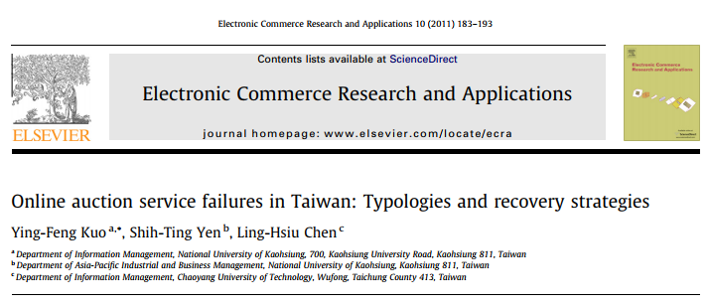
System Explanation Based from a Paper
Based on a paper researching of online auction services in Taiwan
Providing the added observed value to the online auction platform that satisfies the users

Slide 9

System Explanation Basic Functionality Analysis
Bidding
Selling
Reviewing
Bid Items
See the available items to bid
See the bid history
Register items to sell
Manage items
See the bid process
Coupon
Submit coupon to a finished transaction
Insert reviews to seller/bidder
See other’s people reviews
*functionality features are based on paper
An Application of E-Commerce in Auction Process
Combined with suggestions from base paper

Slide 10
System’s Explanation Non-Functional Requirement
Availability Anytime, anywhere via internet-connected browser
Languange Using Bahasa as it’s main languange
Performance A page is expect to be loaded <= 3s*

Slide 11
System’s Explanation Non-Functional Requirement
Maintainability Application design, constructing codes and structures should be maintainable since feature changes are often done
Positive User Experience Must create a good impression via user experience
Authorization
Each users provided an account (tested within functionality)

Slide 12
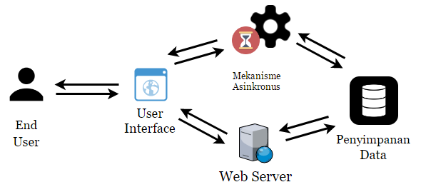
The System - Explanation Application Fundamental Architecture

Slide 13
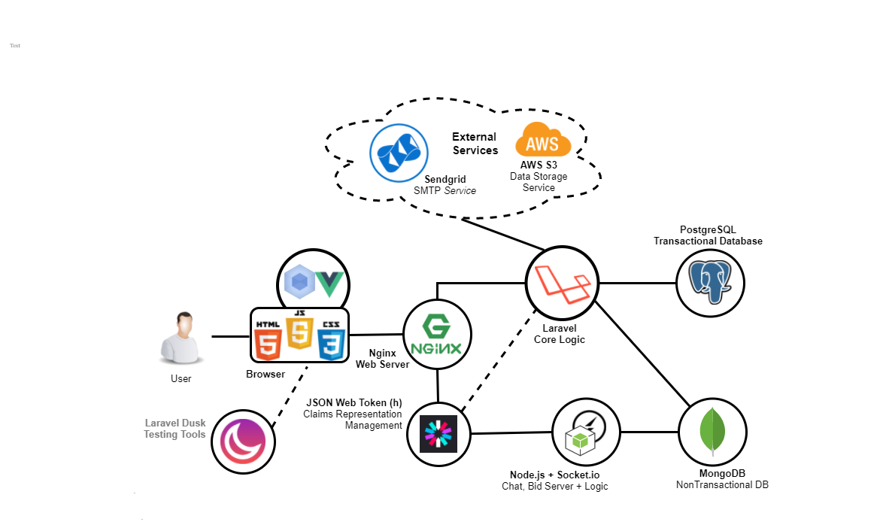
The System - Explanation Technology Choosements

Slide 14






Relation to Andre’s Work
Different back end on each
Same database
1 Database
Web
Application
Android Application

Slide 15
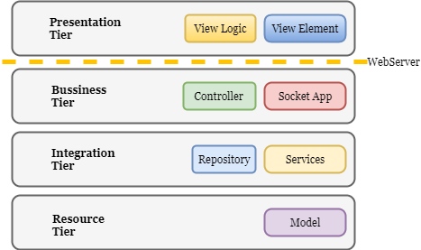
The System - Explanation Tiers
Application consists of 4 layers, each of them own their responsibility.

Slide 16
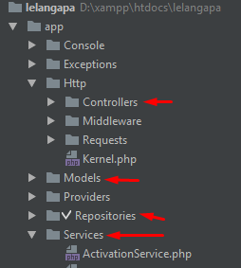
The System - Explanation Tiers
Application consists of 4 layers, each of them own their responsibility. p

Slide 17
Test & Evaluation
Author :
Ronauli Silva Natalensis Sidabukke - 5113100142
Undergraduate Thesis Presentation (KI141502) – Plan B
Rancang Bangun Aplikasi Web Lelang Online Berbasis Laravel
Disclaimer Applied

Slide 18
Testing & Evaluation
Test Methodologies
Maintainability Assesment via Developer Survey
User Experience Assesment via Survey
Functional Testing manually
Speed Test
Recorded Chrome Developer Tools

Slide 19
Testing & Evaluation – Functionality Test
Functionality Test
Testing & Evaluation – Functionality Test
Recaps
Scoreboard:
Passed : 14/17
(Once passed) : 1 Reviews
Unfinished : 1 feature (searching)
Buggy features:
Automated mail : Expired free account, have to reconfigure all the settings on new account

Slide 20
Testing & Evaluation – Functionality Test
Recaps
Misconception between Developers
On Management Review Function
Creating duplicate tables & mechanism for same feature
Premature Optimization
Want to implement service worker in Vue for better performance
Learning gaps for vue is actually high, cannot be finished

Slide 21
Testing & Evaluation – Speed Test
Speed Test Insights
Google Browser Developer Tools record the time log based on this segmentation:
DOM Loading
The time html page returned from web server
Scripting
Time taken to fetch scripts and assets
Rendering
Rendering all content, scripts and assets to browser page

Slide 22
Testing & Evaluation – Speed Test
The Result
Average Loading Time : 2,9 ms
Back-end is fast enough, but scripting (fetching assets) are slower anyone else Scripting takes 75% of the loading time
Slowest loading is on item show page Main culprit : Uncompressed Image

Slide 23
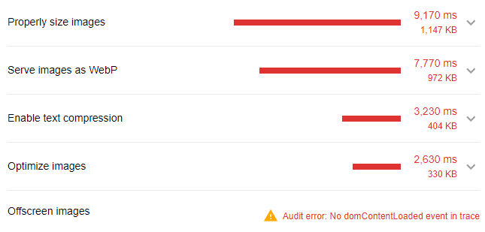
Testing & Evaluation – Speed Test
Result Analysis
Opportunity analysis from Lighthouse on the slowest page

Slide 24
Testing & Evaluation – Maintainability Assesment Questionnaire Design
KPI Based on A Software Maintainability Evaluation Methodology
Peercy, David E. IEEE TRANSACTIONS ON SOFTWARE ENGINEERING, VOL. SE-7, NO. 4, JULY 1981
Defined on papers that:
Maintainability lies on 2 fundamentals Documentation(40%) & Source Code(60%)
Can be measured through 5 parameters beside
Measured in 5-scale ( Completely Agree to Comp. Disagree )
Evaluator agreement goal is 0.8
Parameter
Modularity
Descriptiveness
Consistency
Simplicity
Trackability

Slide 25
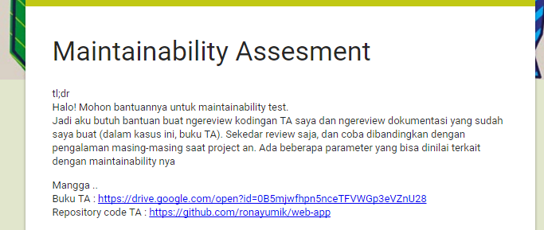
Testing & Evaluation – Maintainability Assesment Survey Methodologies
KPI Based on A Software Maintainability Evaluation Methodology
Peercy, David E. IEEE TRANSACTIONS ON SOFTWARE ENGINEERING, VOL. SE-7, NO. 4, JULY 1981
Conducted online (via google forms)
Reviewing code via github and reviewing documentation via undergraduate thesis book (buku TA)

Slide 26
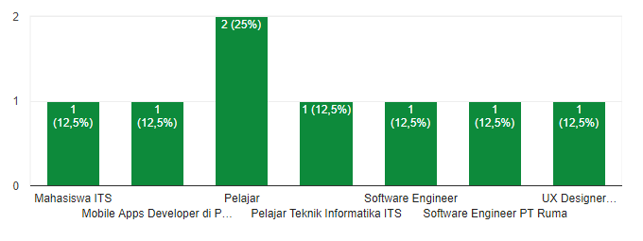
Testing & Evaluation – Maintainability Assesment Respondent’s Statistics (1)
8 respondents, all are already experienced medium to high tensity projects , some of them already works on IT Companies (all of them are TC’s alumnaes)

Slide 27
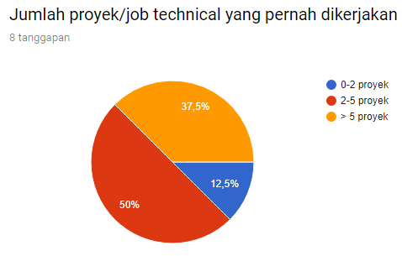
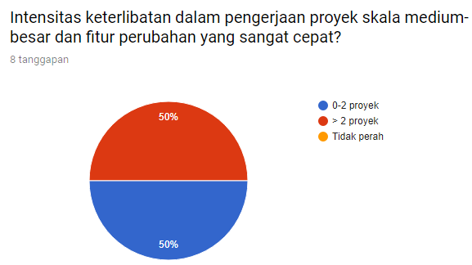
Testing & Evaluation – Maintainability Assesment Respondent’s Statistics (2)

Slide 28
Testing & Evaluation – Maintainability Assesment The Result
KPI Based on A Software Maintainability Evaluation Methodology
Peercy, David E. IEEE TRANSACTIONS ON SOFTWARE ENGINEERING, VOL. SE-7, NO. 4, JULY 1981
Parameters | Source Code | Documentation | Average
Modularity | 83% | 83% | 83%
Descriptiveness | 83% | 78% | 80%
Consistency | 78% | 73% | 75%
Simplicity | 75% | 73% | 74%
Trackability | 75% | 73% | 0,77
Average | 79% | 76% | 77%
Weights | 60% | 40%
Final Score | 77% (96% accomplished to target score)

Slide 29
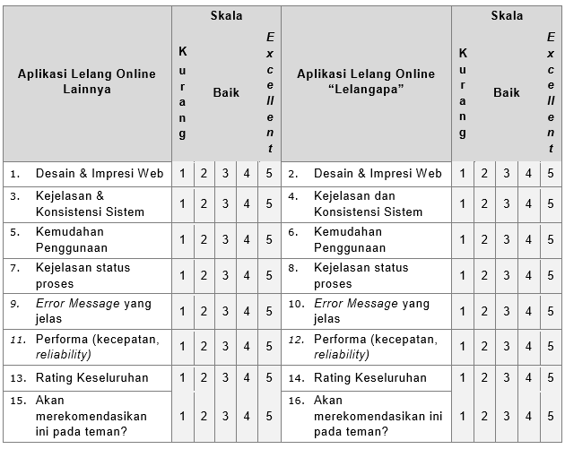
Testing & Evaluation – User Experience Questionnaire Design & Technique
KPI Based on Development of an Instrument Measuring User Satisfaction of the Human-Computer Interface
Proceedings of ACM CHI'88 Conference on Human Factors in Computing Systems 1988-05-15 p.213-218

Slide 30
Testing & Evaluation – User Experience The Results
Parameters | Other App’s Average Score | Lelangapa App’s Average Score | Difference (in %)
Design & Web Impression | 3,3 | 4,1 | ⬆ 20%
Consistency & Descriptiveness | 3,5 | 4,2 | ⬆ 17%
Easiness | 3,1 | 3,9 | ⬆ 21%
Clear Error Message | 3,7 | 3,9 | ⬆ 5%
Clear Process Status | 3,3 | 4 | ⬆ 18%
Performance | 3,7 | 3,8 | ⬆ 3%
Rating on average | 3,7 | 4,3 | ⬆ 14%
Would recommend this to friend? | 3,4 | 4,0
Total Average |  |  | ⬆ 15%

Slide 31
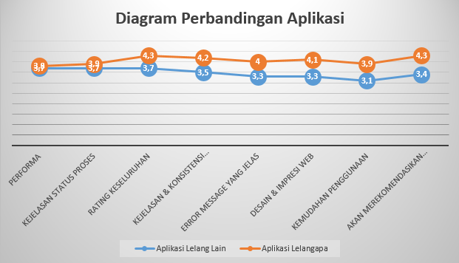
Testing & Evaluation – User Experience Result’s Summary

Slide 32
Testing & Evaluation Evaluation’s Summary
Test | Score | Conclusion
Functionality | 14/17 | 82,3 % finished
Speed | 3.2 s | Exceeds 6% Notot too bad either
Maintainability | 77% | 96% accomplished
User Experience | +15% | Good

Slide 33

Finale
Conclusions
Suggestions
Future Enchancements

Slide 34

Finale Conclusions
Software Design Initiation is really important for a flexible and long-lasting software (which is really needed)
Bussiness aspects is important to create an e-commerce related application, if we want to create a fully-functioned app.

Slide 35




Finale Suggestions
JWT Expiration
Take care of JWT Token Expiration & Refresh Token Mechanism and its coordination to Back-end server
Legal
Involvements
Involve a legal financial authority in the bussiness process design & monitoring of online auction app.

Slide 36
Finale Further Enchancements
Image Compression (often called Image Optimization) in optimizing a website’s performance
User Experience’s Impact to Business Matter Delivery
How the Google Search Delay Impacts on Its Revenue
Analyzing the eye movements to the information-eyecatchiness to deliver key values to the customers
Early Fraud Detection from Bid Activities
Credit Scoring from Customer Purchasement & Transaction’s Pattern
Early Fraud Detection & Succesful Transaction Pattern Rate using Machine Learning Methods

Slide 37
Thank you.
This is the end of this presentation.

